Slide 1
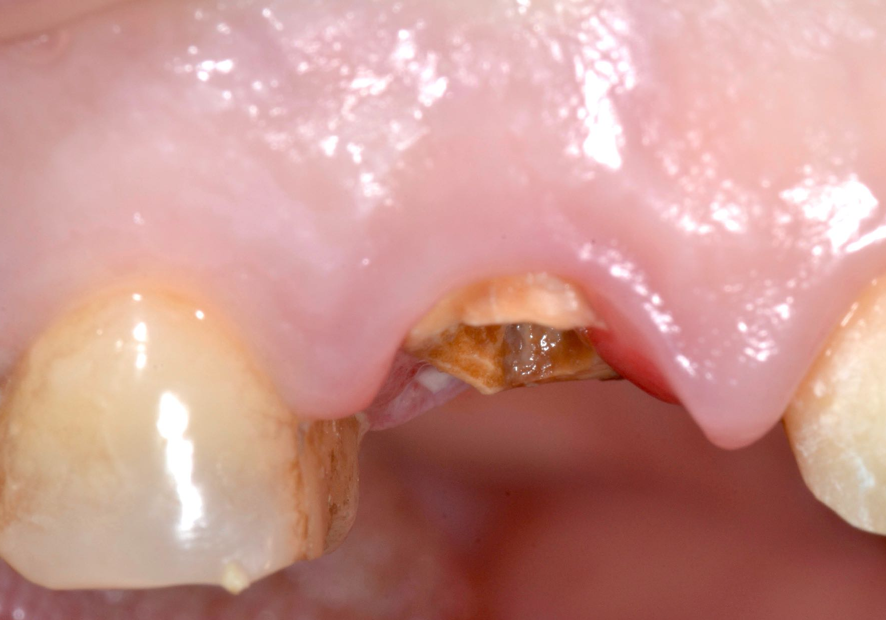
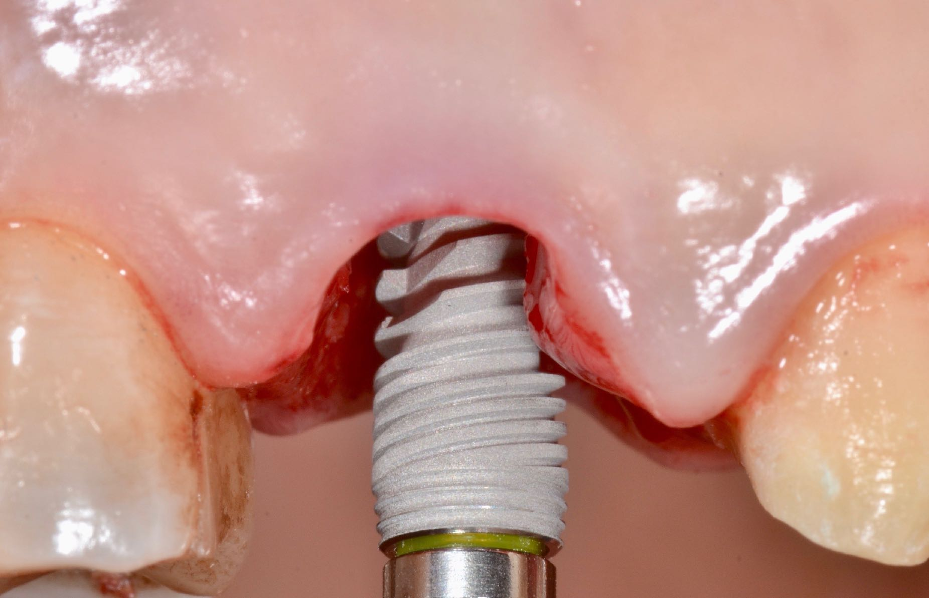
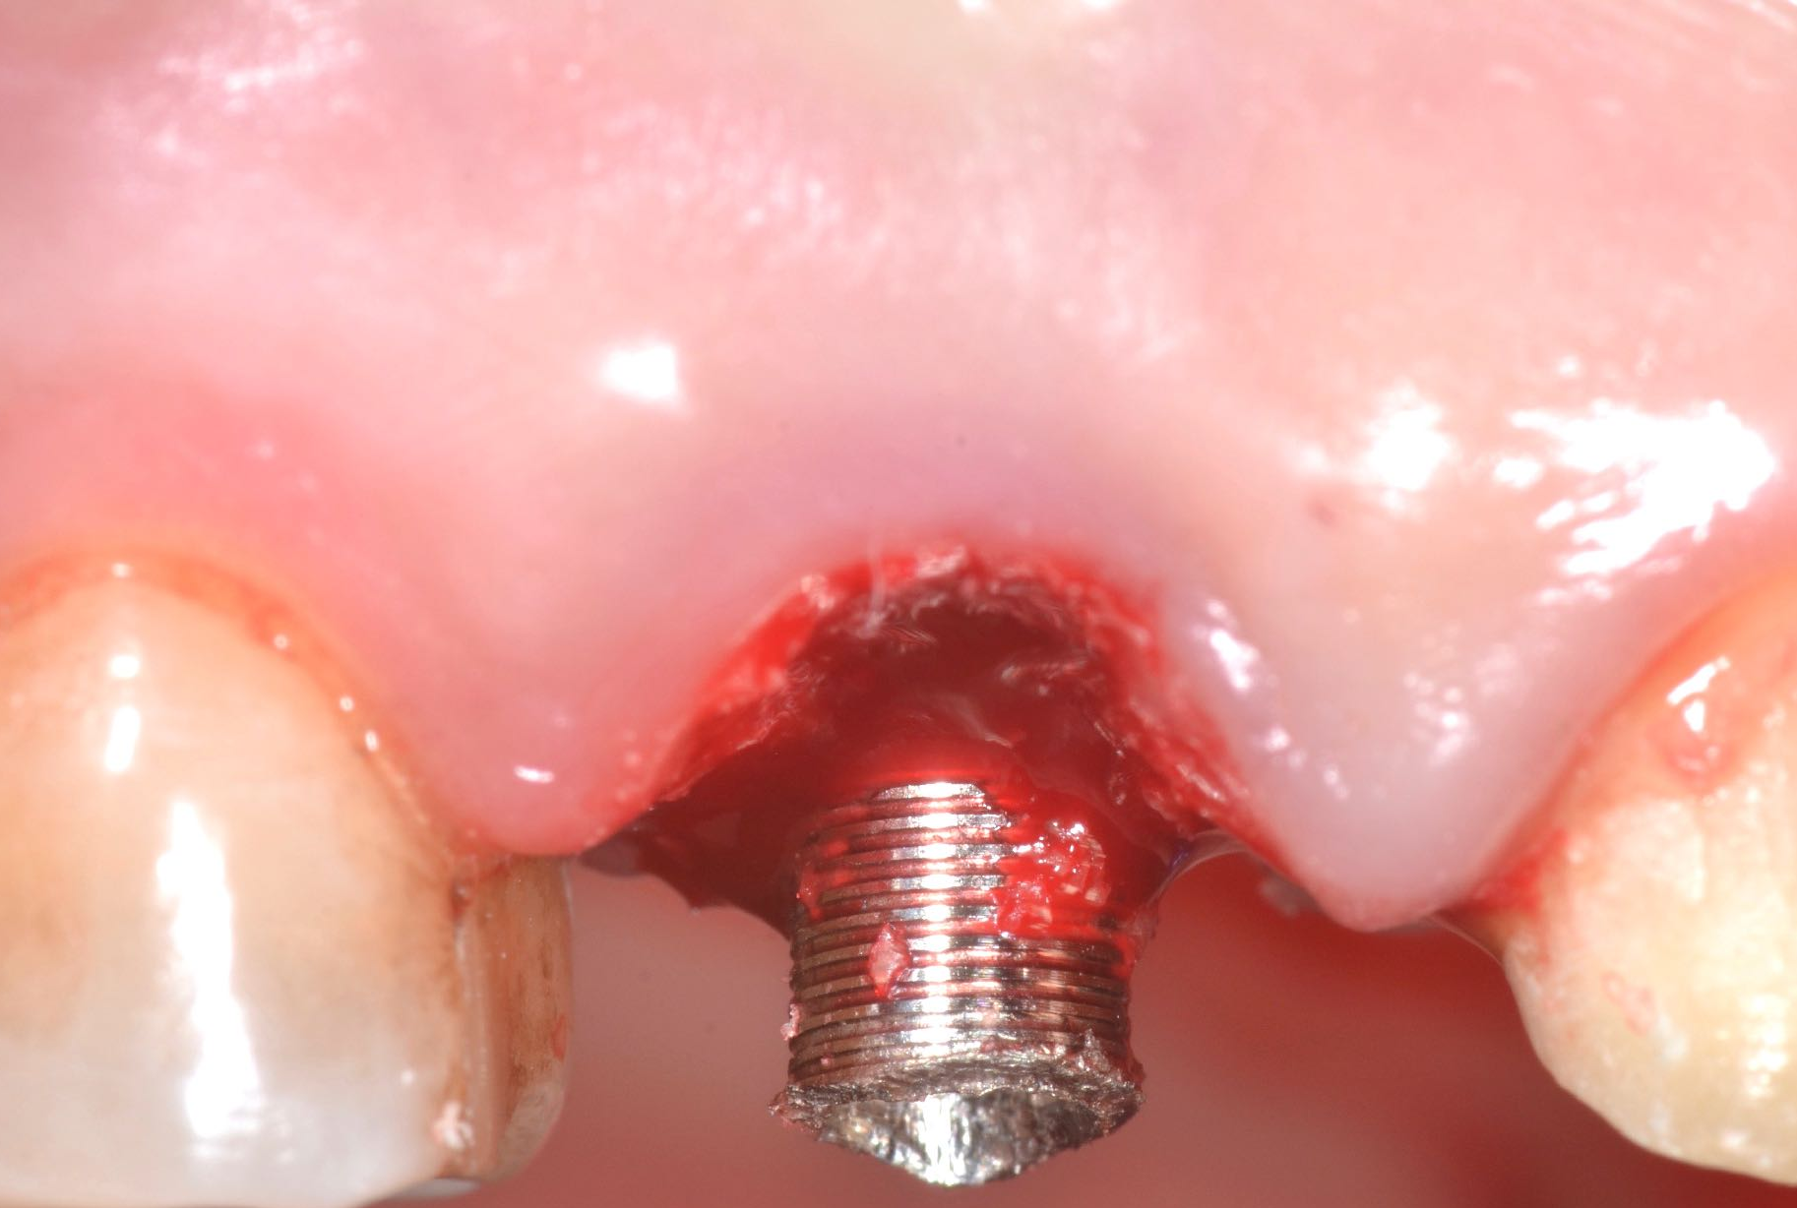
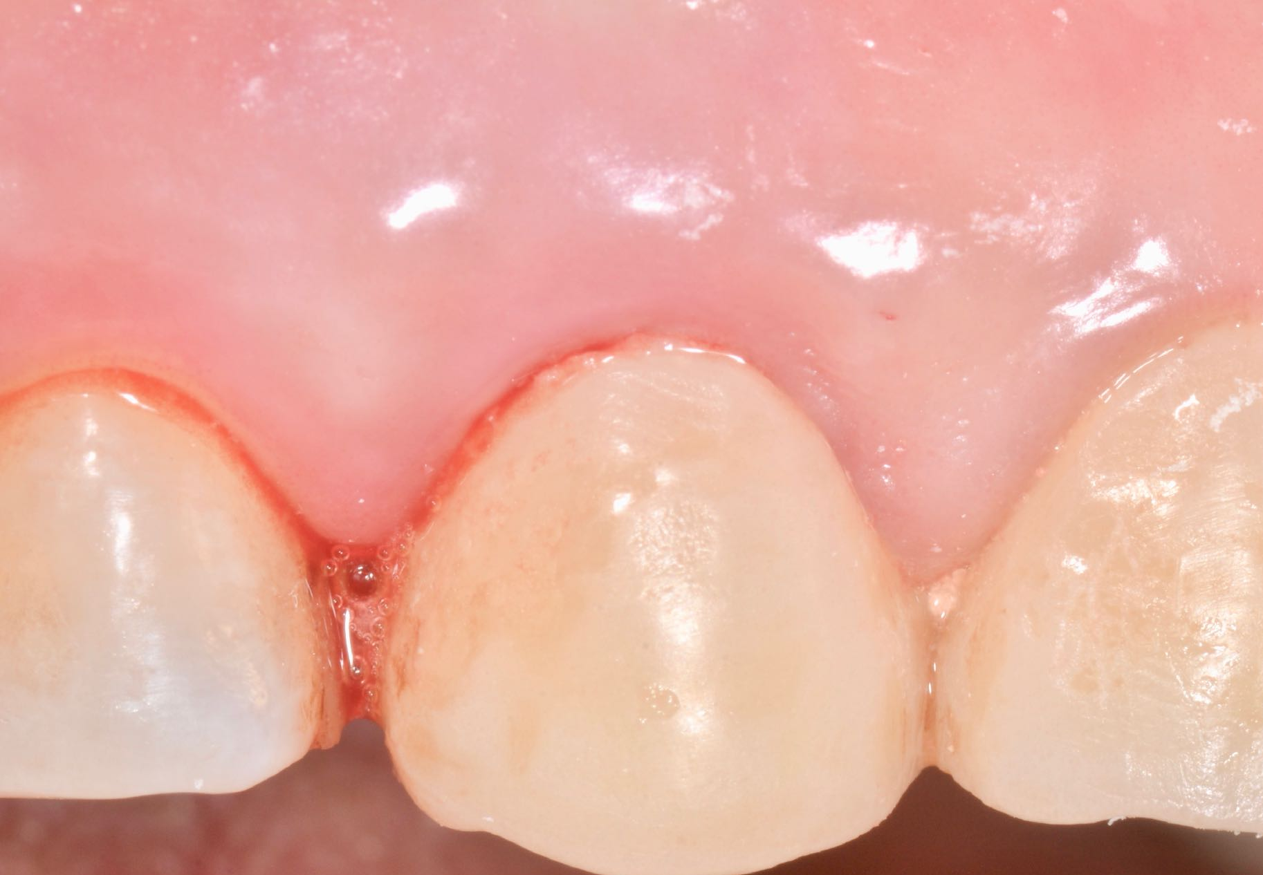
Preliminary Clinical Experience of Implants with Multiple Condensing Thread Design in Poor Bone Qualities and Immediate Loading
Peron Cristian, DDS*, Georgios Romanos, DDS, PhD, Prof Dr med dent§
*Private Practice, Turin, Italy, §Department of Periodontology, Stony Brook University, School of Dental Medicine, Stony Brook, NY
Introduction: The implant rehabilitation protocols have been redefined in order to meet patient's growing expectations by improving comfort, aesthetics and reducing the total treatment time. Primary stability is a fundamental prerequisite for a success of osseointegration process which determines the prosthetic reconstruction time, especially in poor bone quality and early/immediate loading. In the immediate loading protocol, insertion torque values have been suggested to be the most valid prognostic factor for this treatment protocol.
The purpose of this preliminary clinical experience was to evaluate the primary stability of implants with multiple condensing thread design (CDTD) immediately in post-extraction and healed sites of the posterior/lateral area of ​​the maxilla and the degree of patient satisfaction with an immediate aesthetic and functional restoration. The geometry of this implant design may improve coronal bone maintenance with a coronal inversion of the neck and with micro- and macro-square of the body could respectively increase the bone to implant contacts (BIC) and insertion and loading of the implant. Moreover, trim-edge self tapping design could prevent the bone necrosis and crooked insertion of implants.
Materials and Methods: Six dental implants with multiple condensing thread design (Anker Implants, Alliance, Kaohsiung, Taiwan) were placed with a minimal invasive surgery in fresh extraction sites and healed sites without the flap elevation. The diameters of implants used varied from 3.5 and 4.5 and the lengths of implants varied from 10 to 11.5 mm. All implants were inserted 2 mm below the bone crest using the surgical protocol. The implant tunnel was prepared by under-preparing the site with a milling cutter 1.2 mm in diameter smaller than the chosen diameter. All implants were immediately loaded with an immediate screw-retained provisional restoration. The evaluation of primary stability occurred with the insertion torque of the micromotor and with the resonance frequency analysis through the Osstell-device immediately after implant placement. The degree of patient satisfaction was achieved by completing a questionnaire regarding intra-operative and postoperative pain, swelling, duration of therapy, aesthetics, giving values ​​from 1 to 5 with a maximum total of 25.
Pre-op
Flapless & Implant
Placement
Temporary Abutment
Immediate Temporary Crown

Slide 2
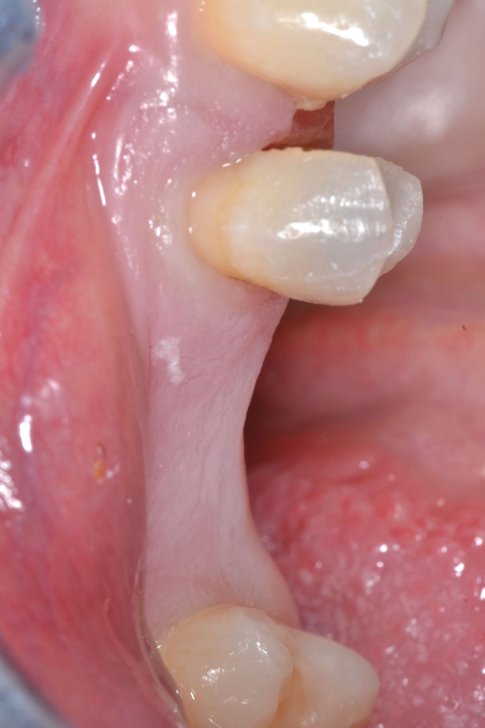
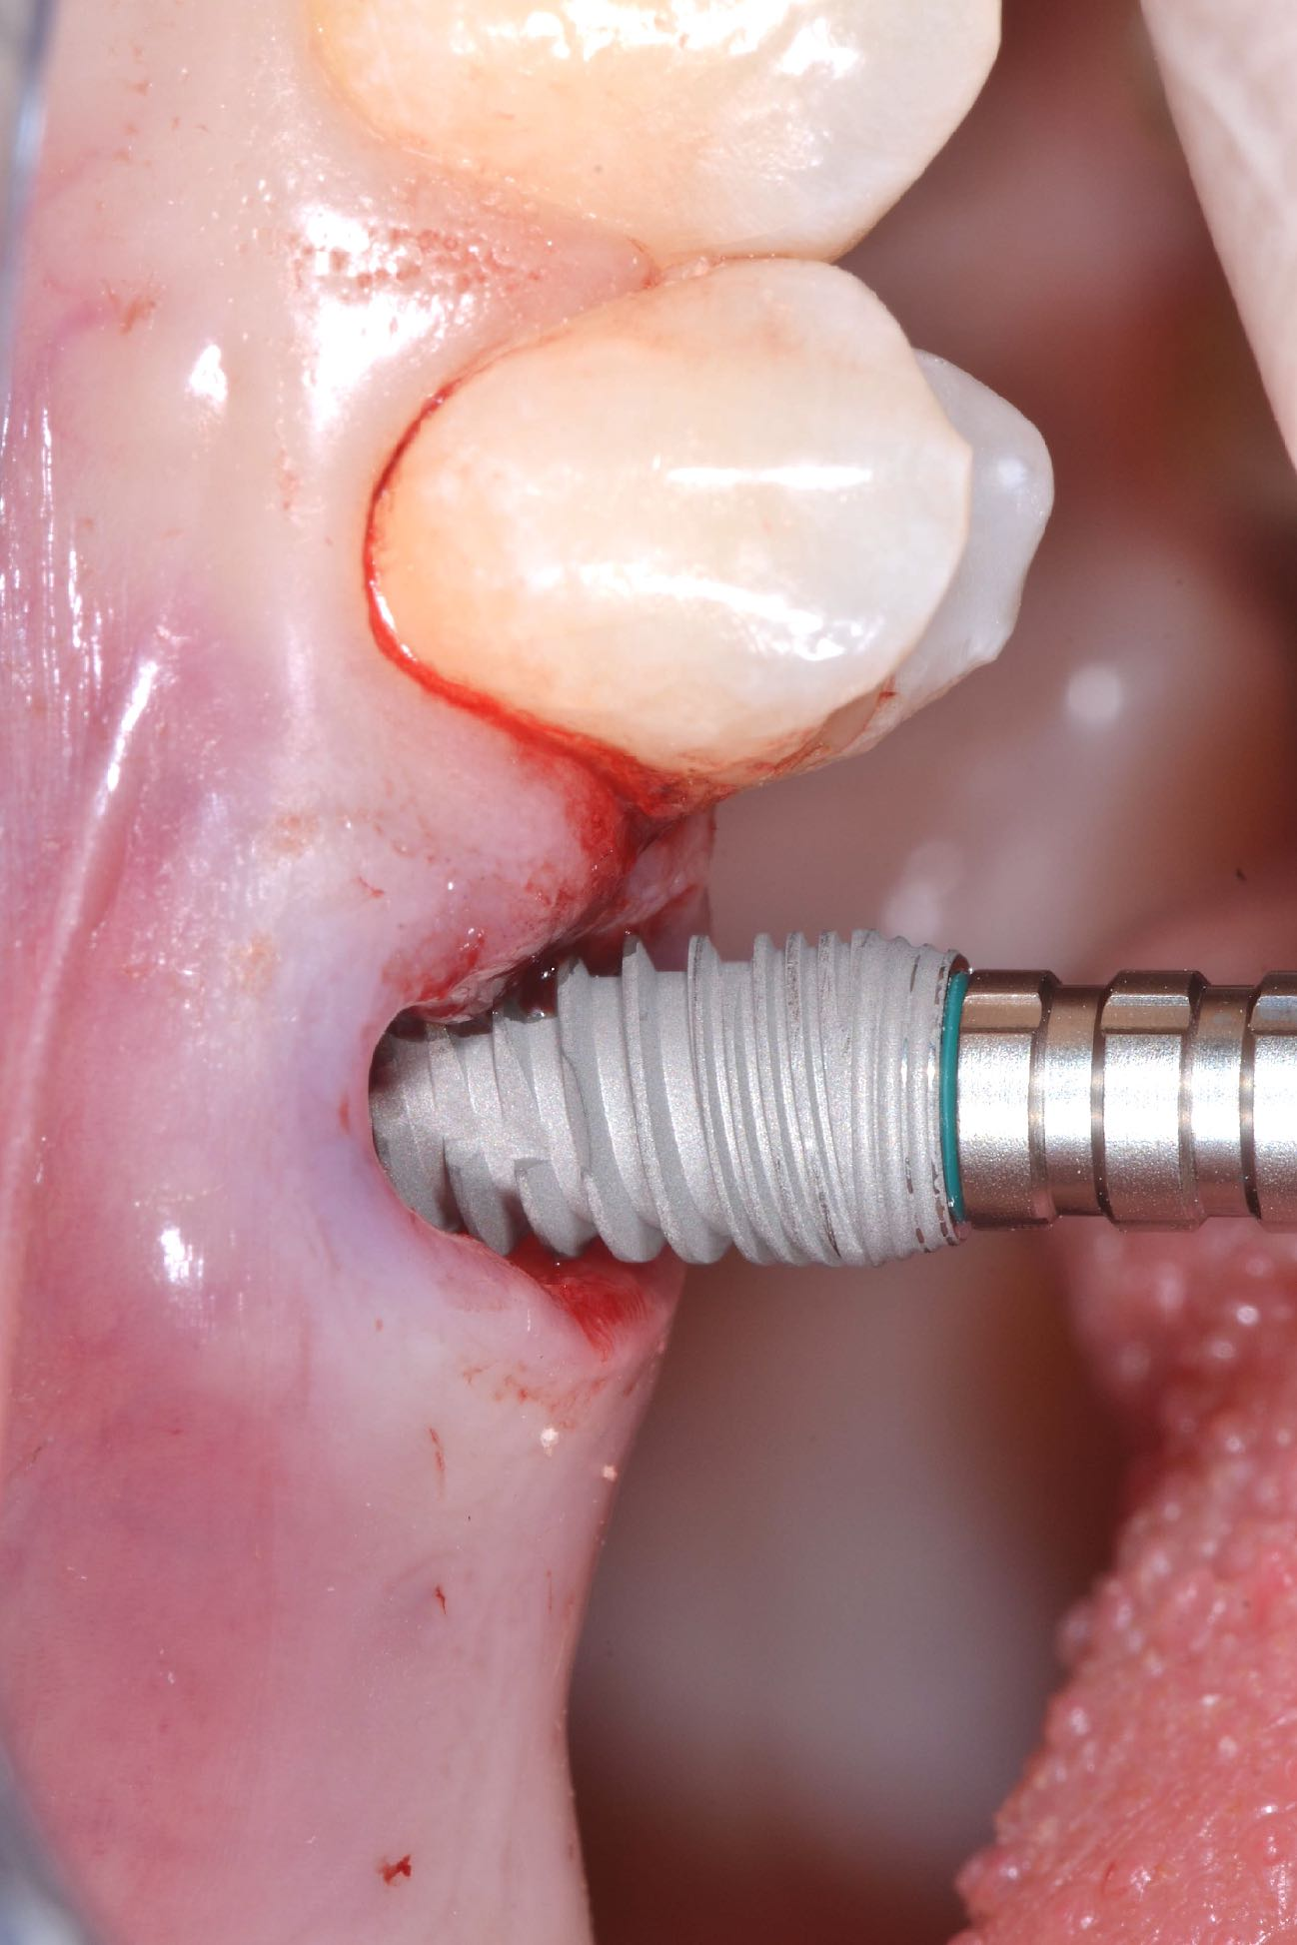
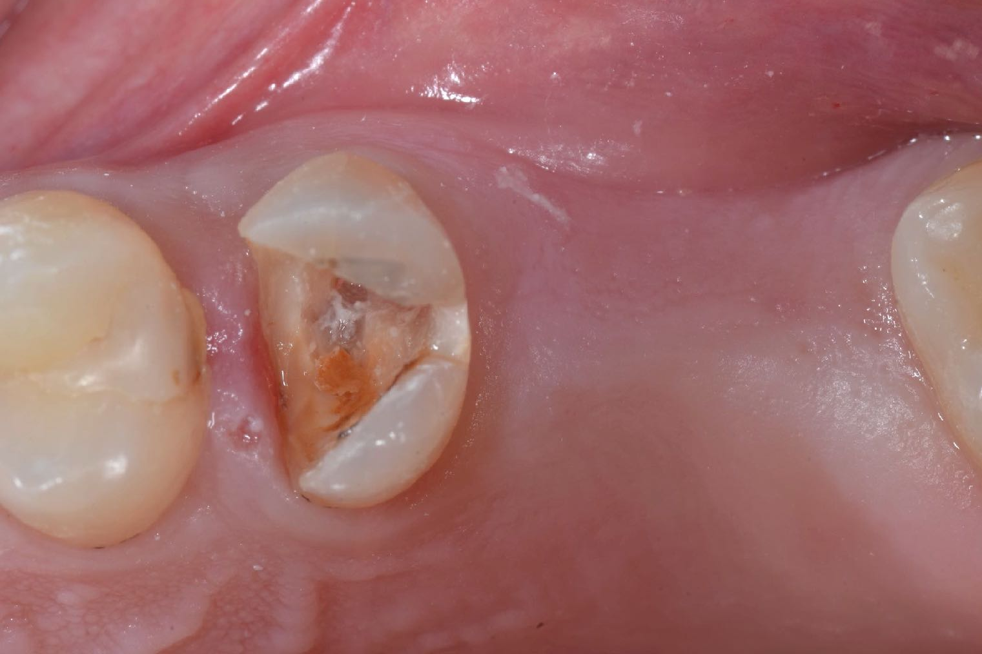
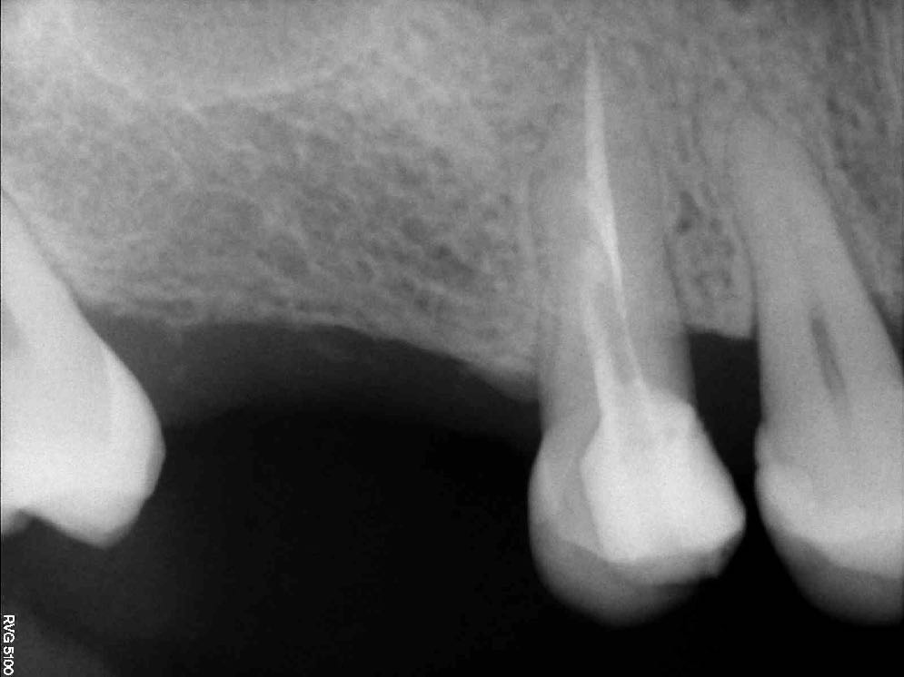
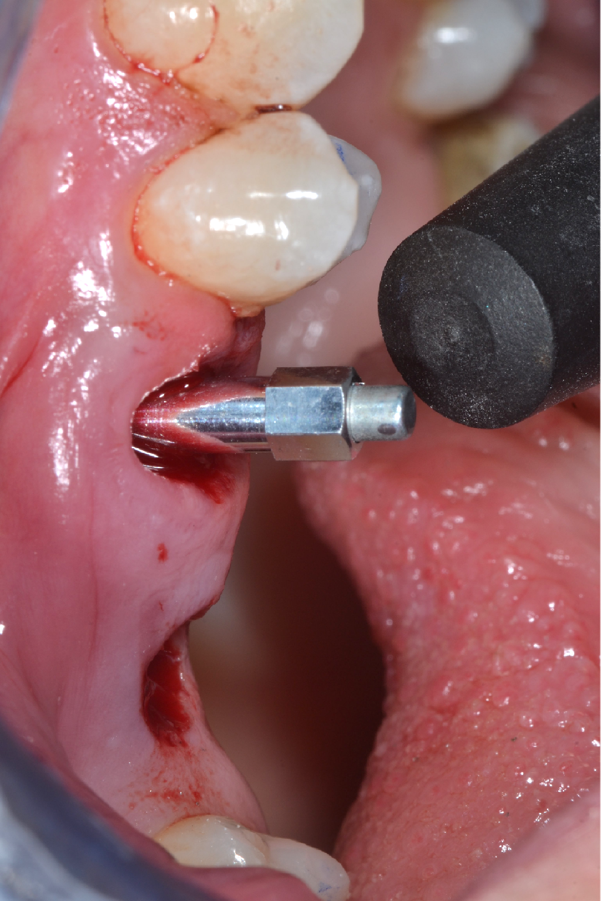
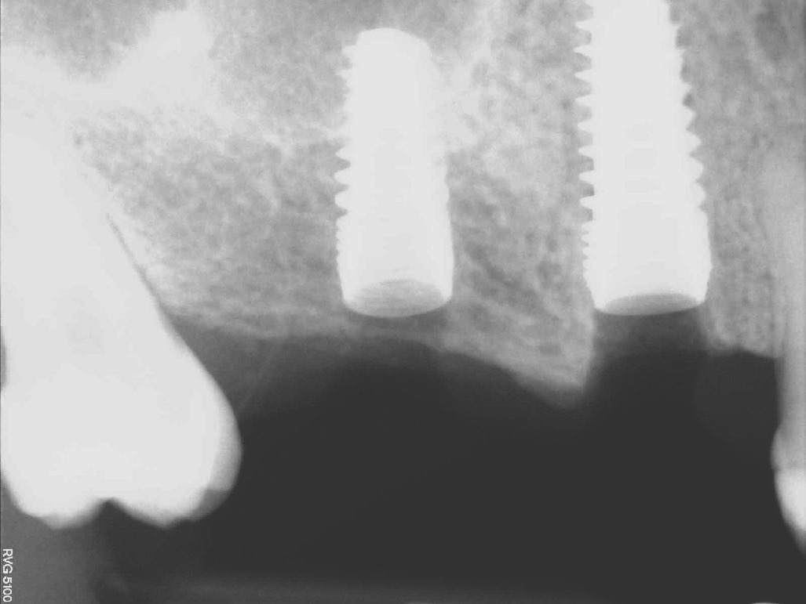
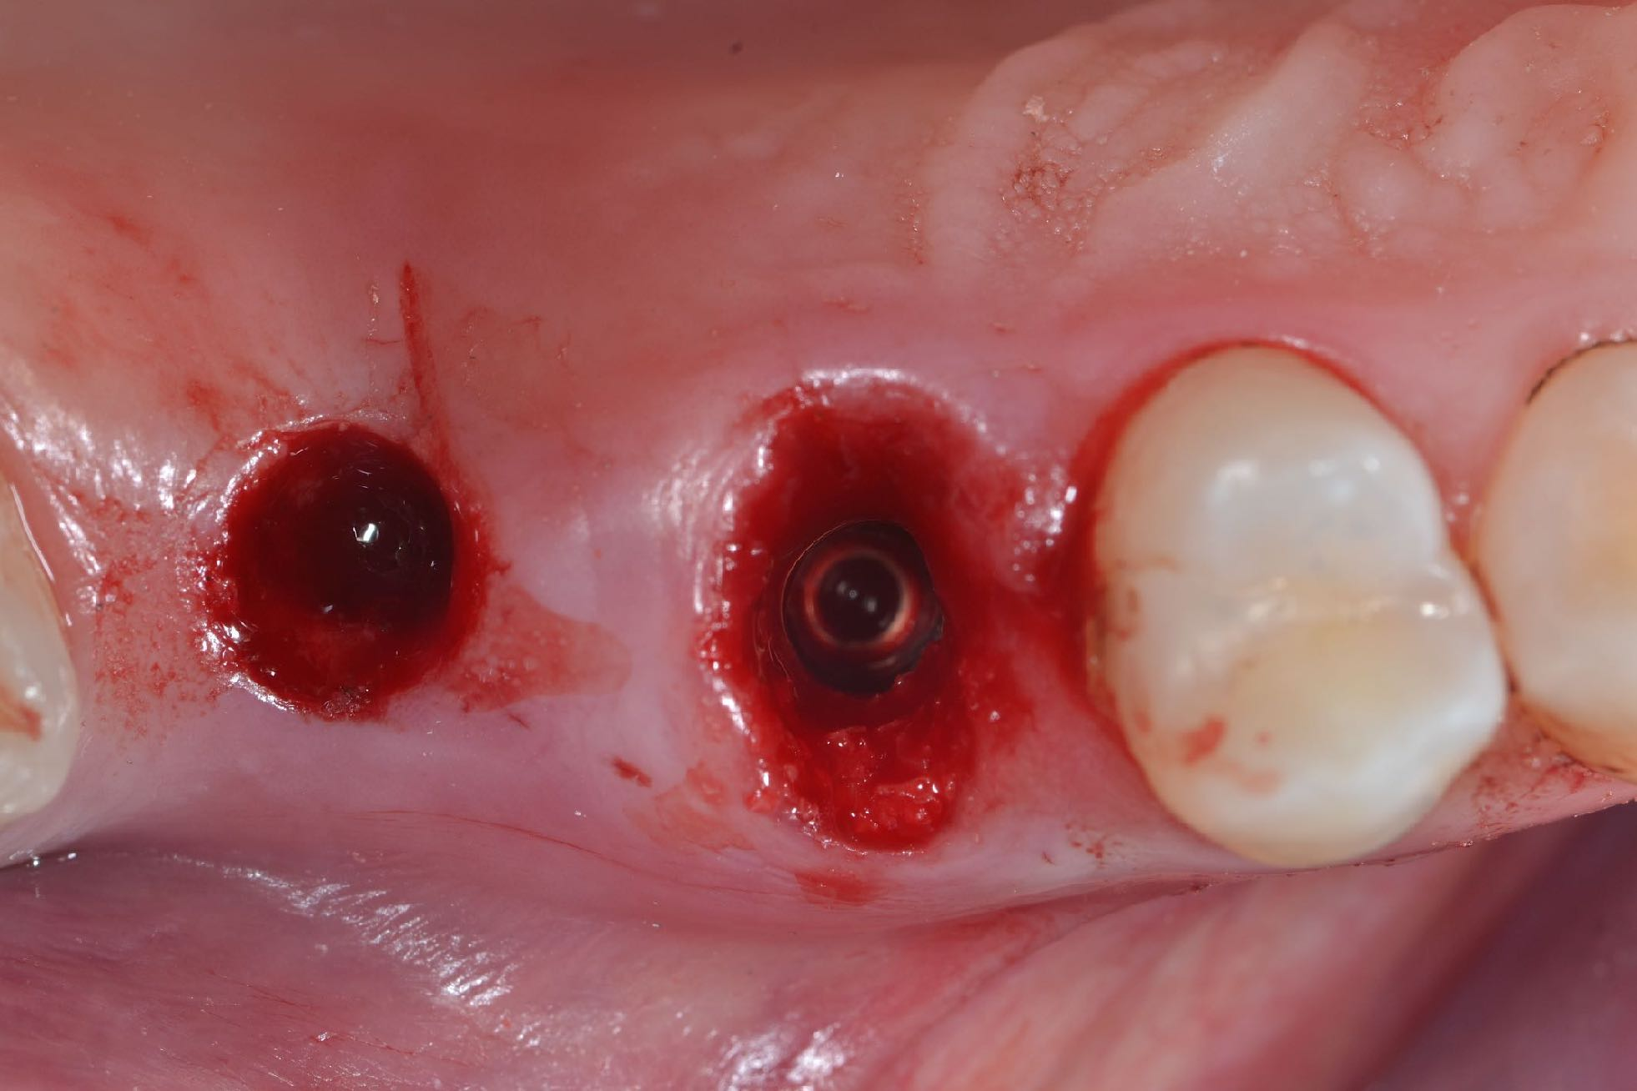
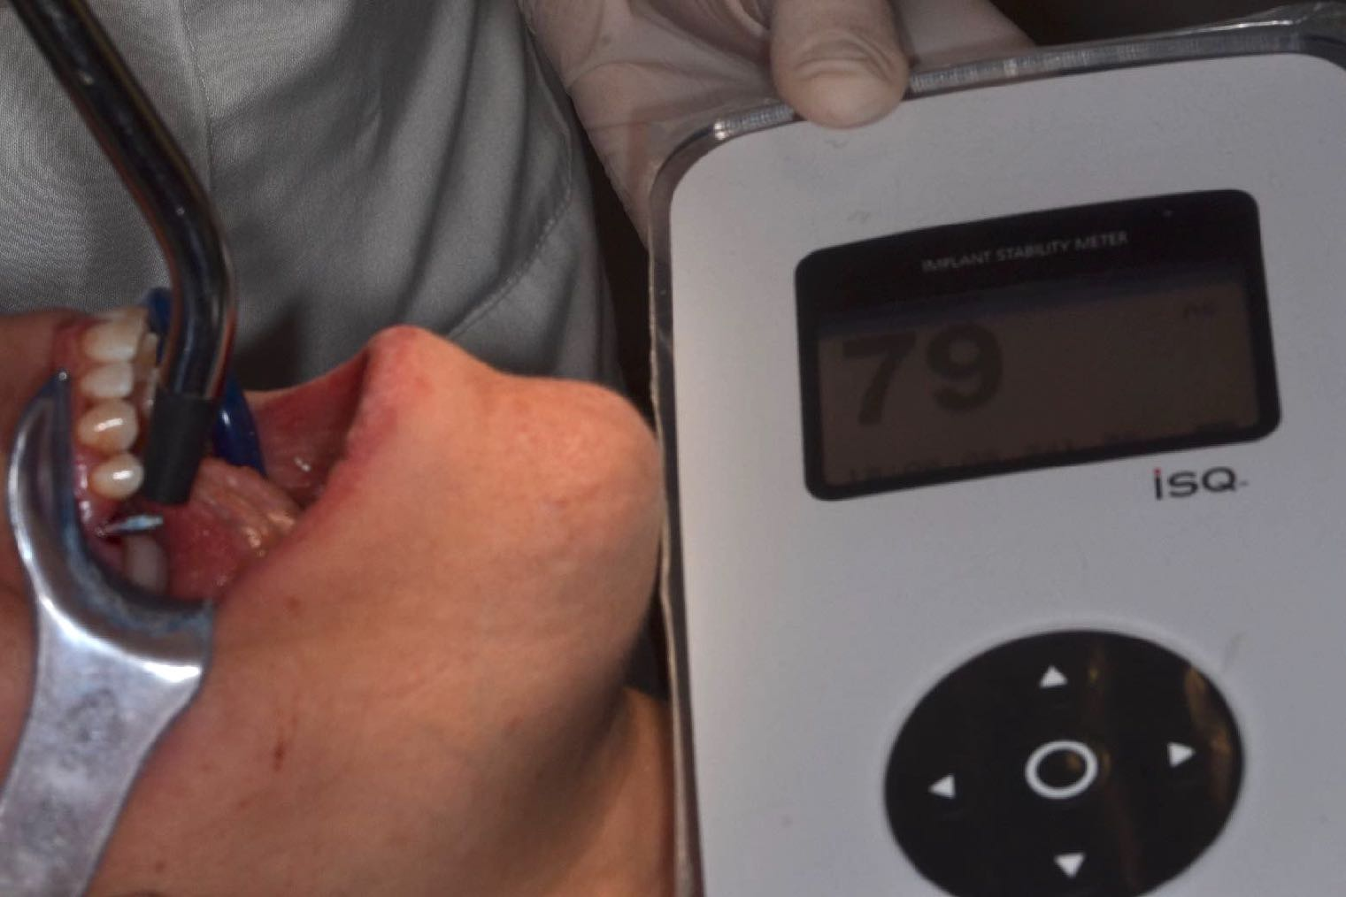
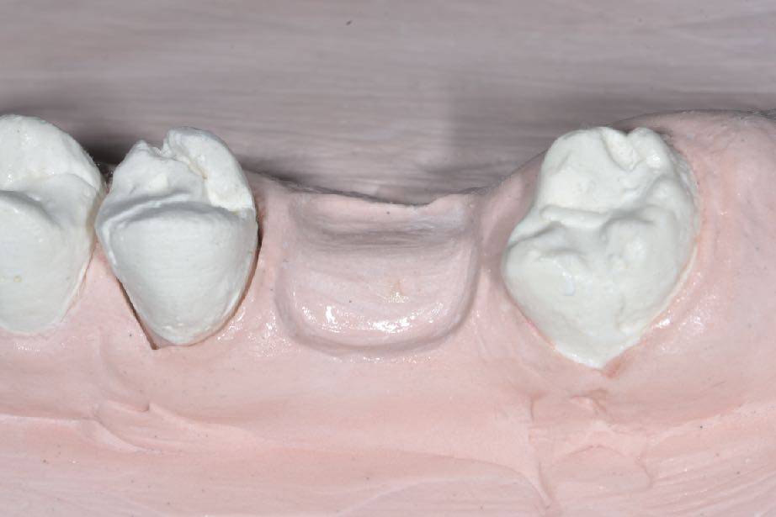
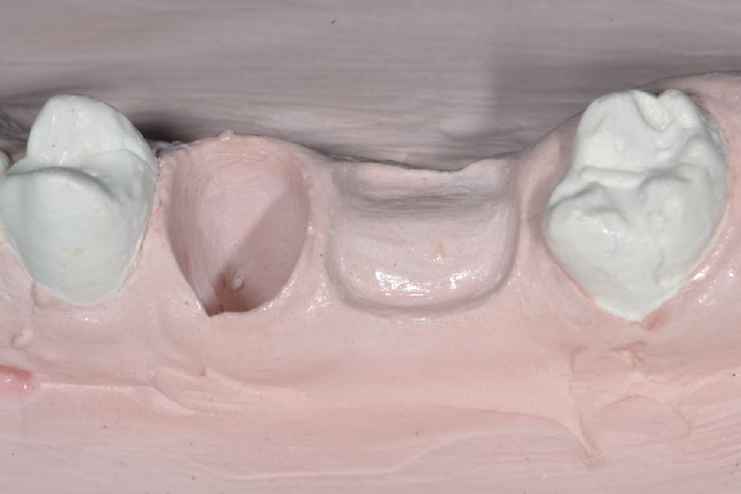
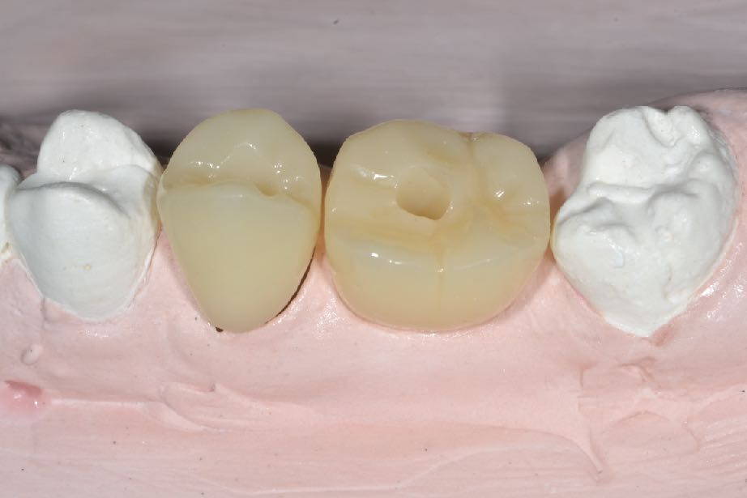
1° Case Report
1
1
2
3
4
5
6
7
8
8
8
Female patient (35 years old) in a good health presenting a crown/root fracture of the second right maxillary premolar and single edentulous space of the first molar.
1) Vertical and horizontal ridge’s dimension of the clinical pre-op situation 2) Radiographic pre-op 3) Implant micro- and macro-design 4) Implant placement 2 mm below to the crestal bone 5) Flapless Surgical Technique 6) Implant stability with the Osstell device 7) Value ISQ=79 8) Model cast to create a provisional restoration following the concept of Socket Healing Guide Technique

Slide 3
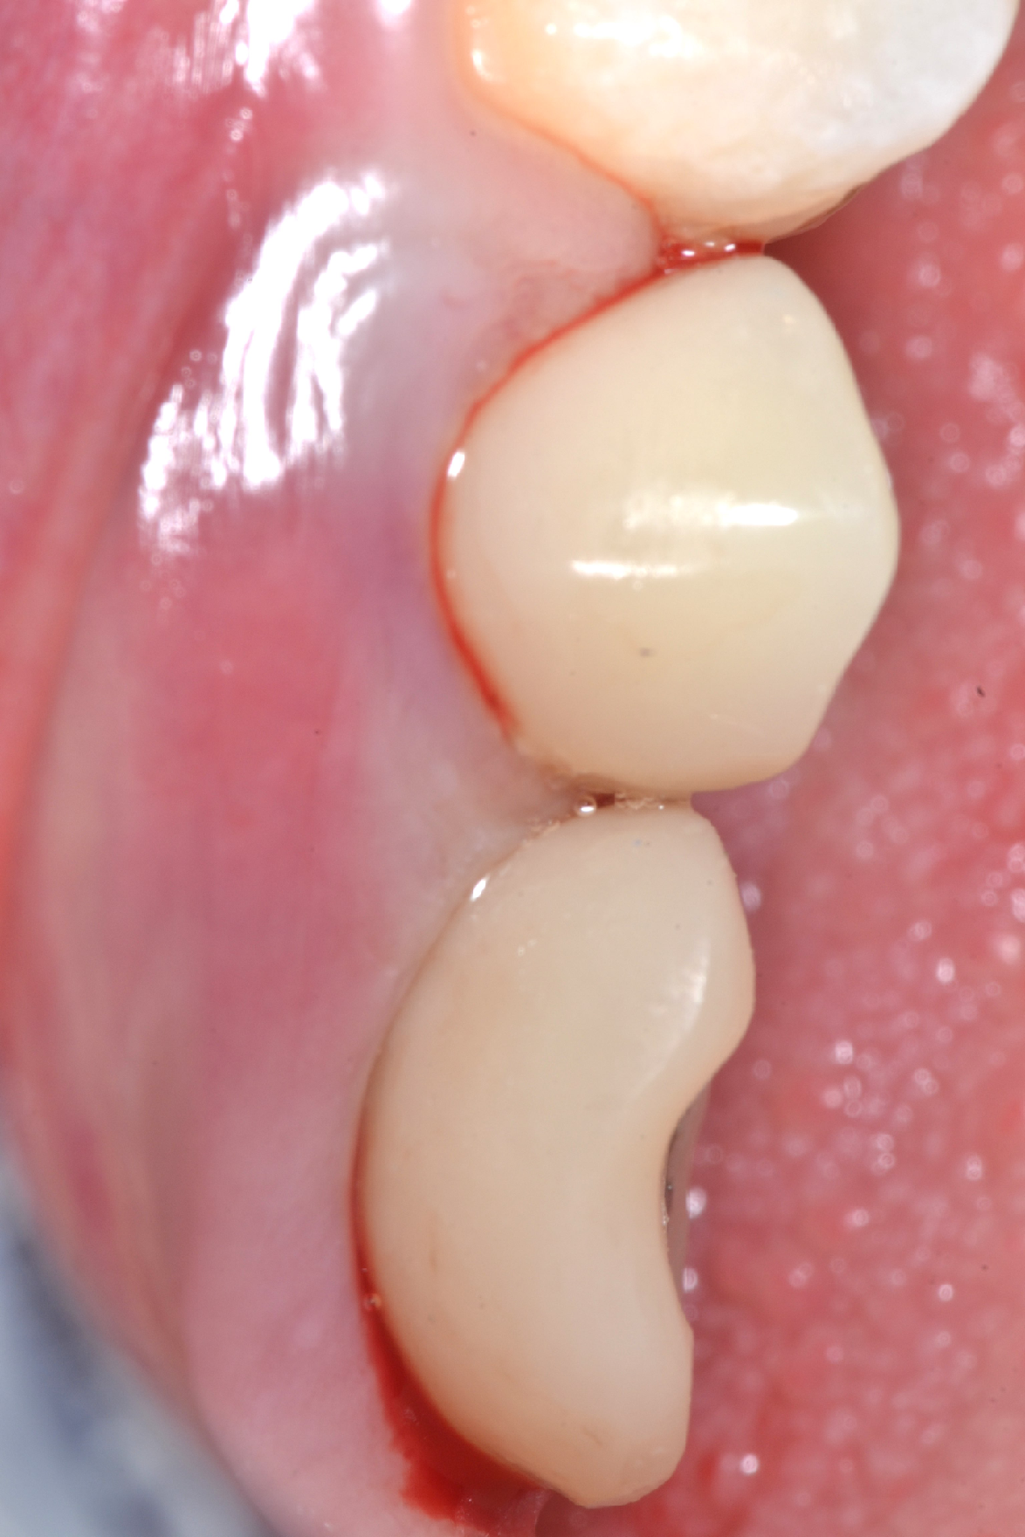
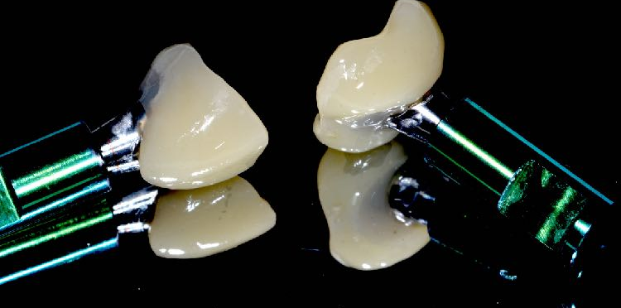
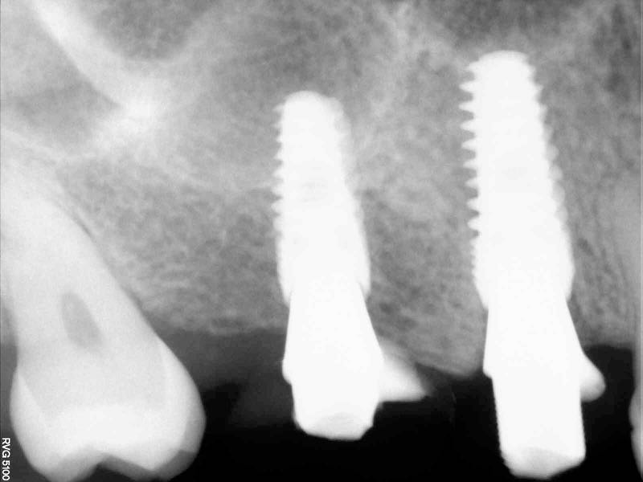
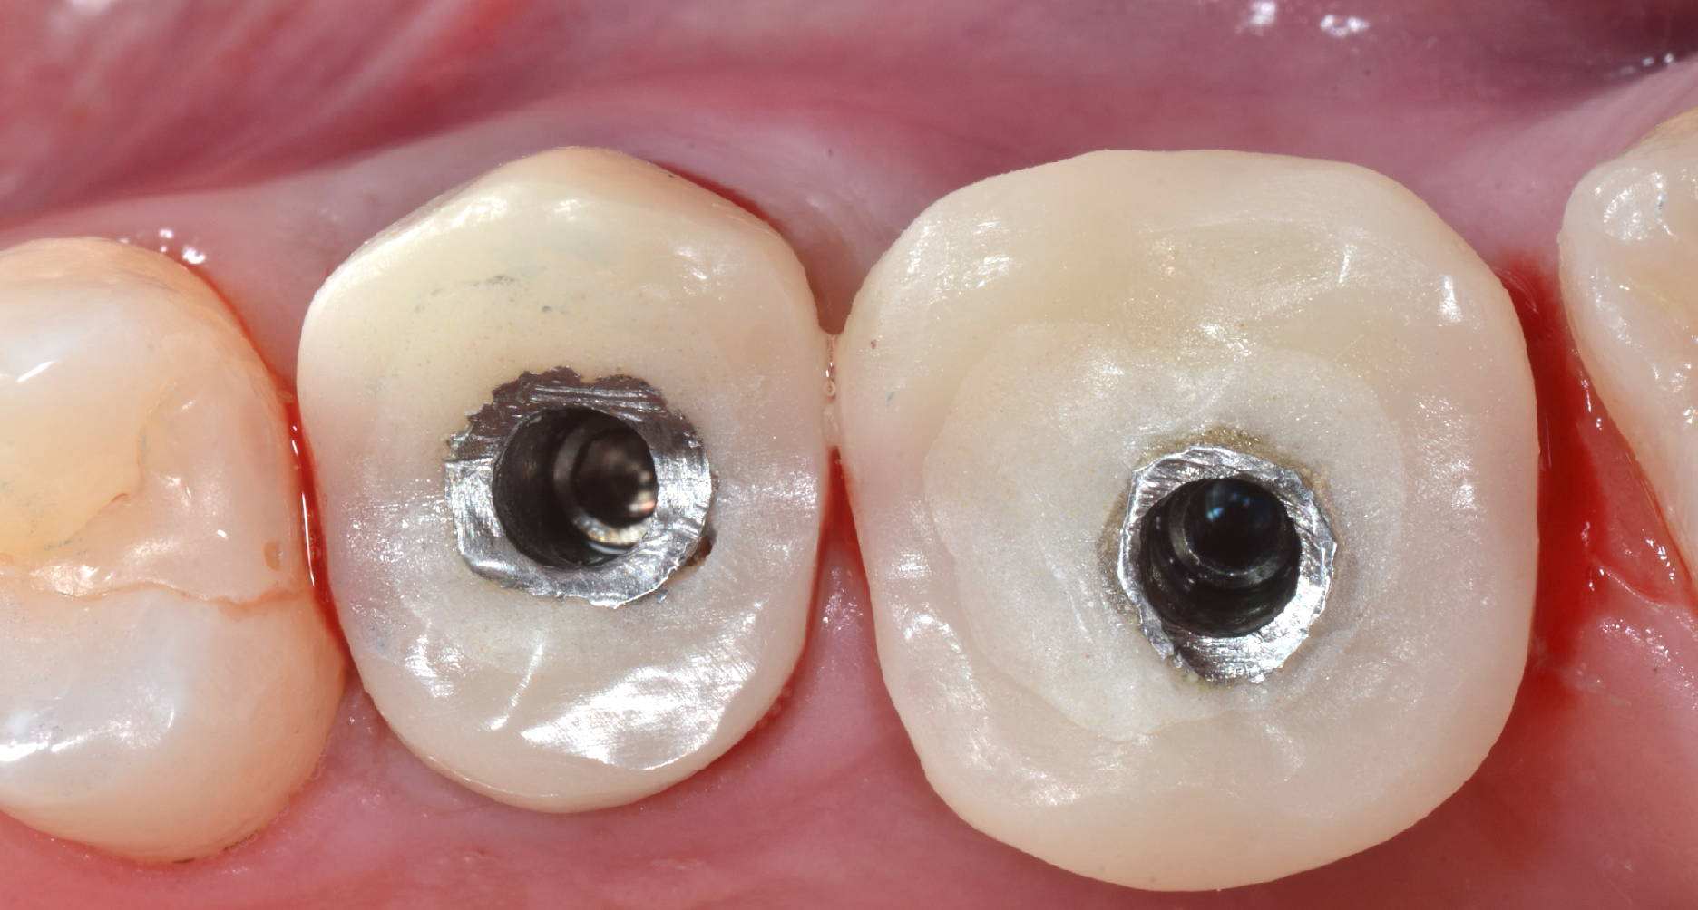
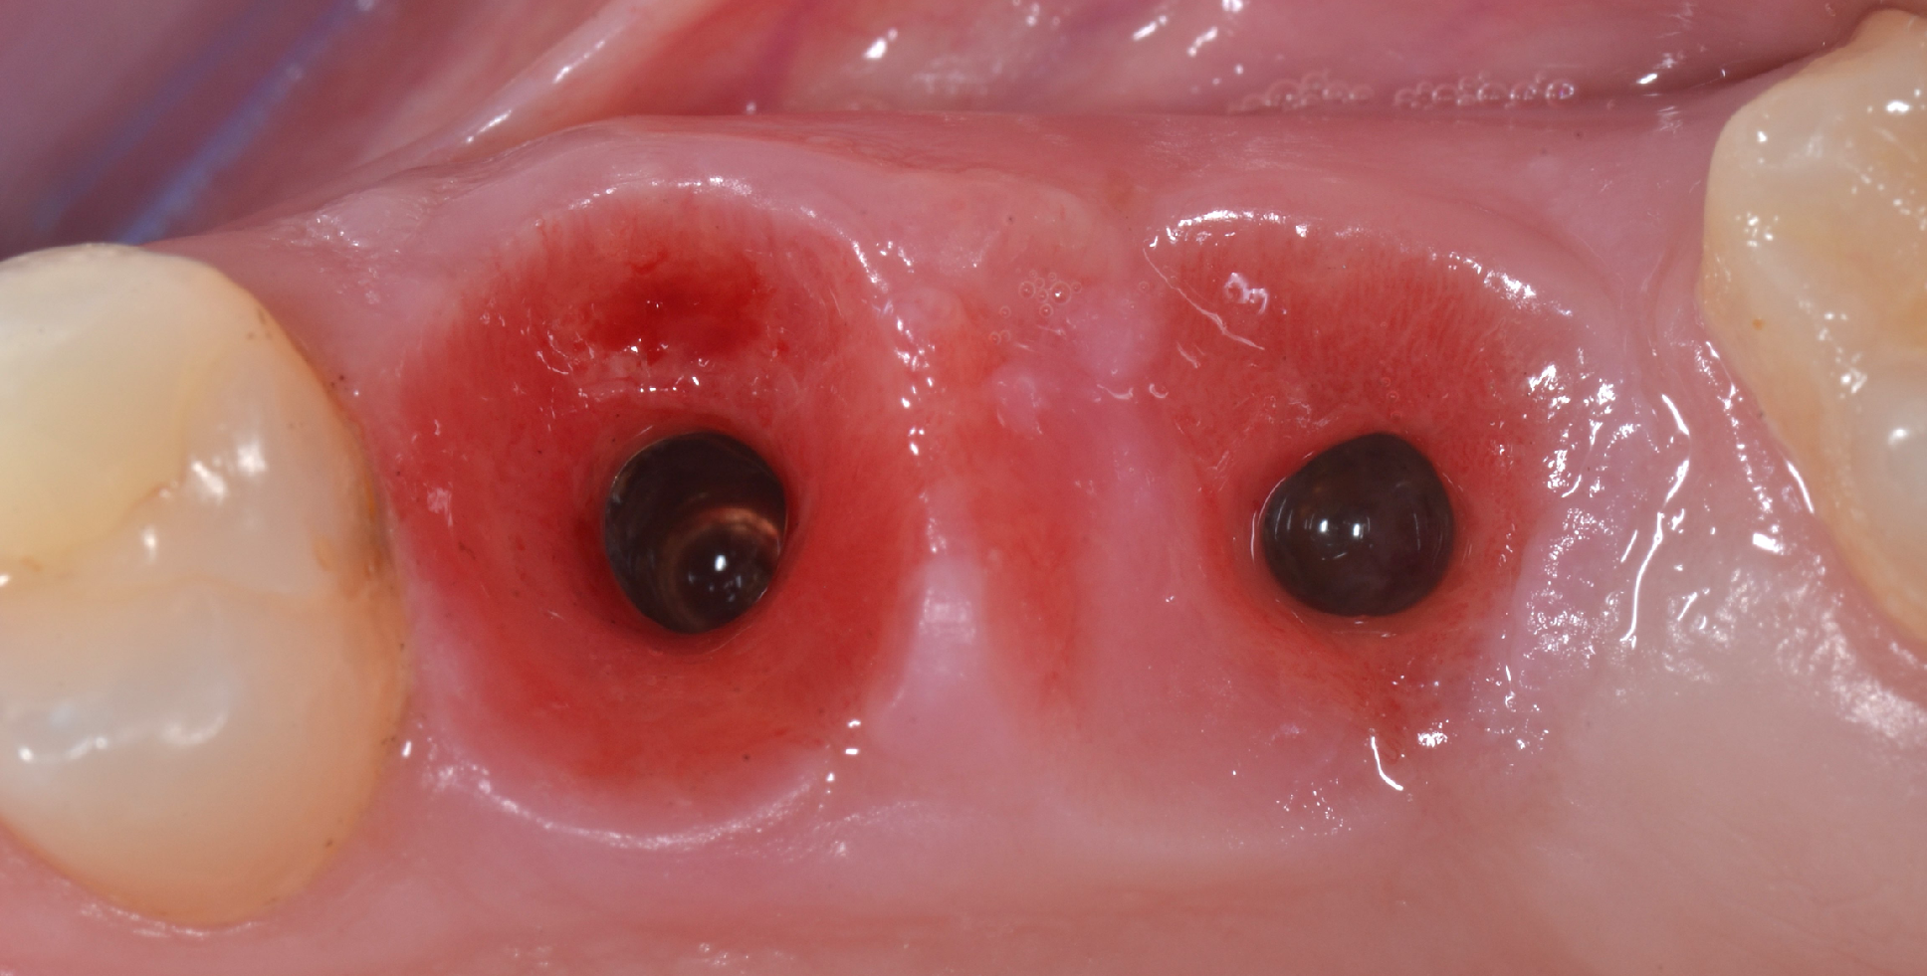
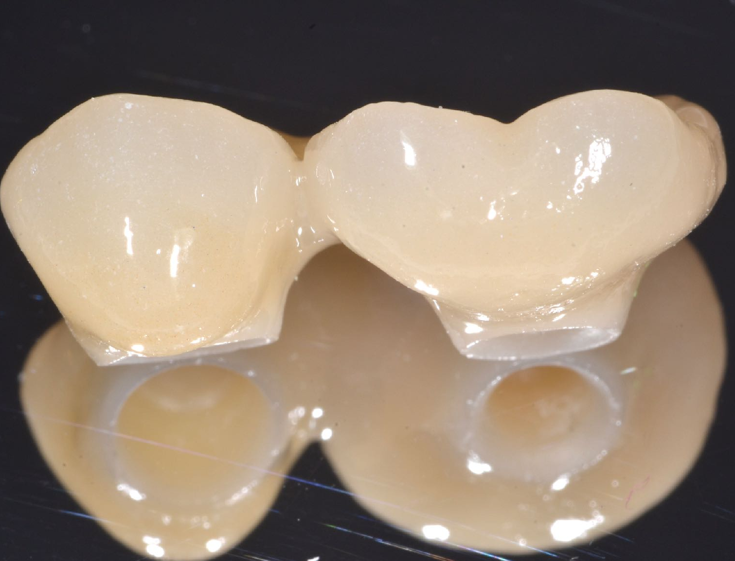
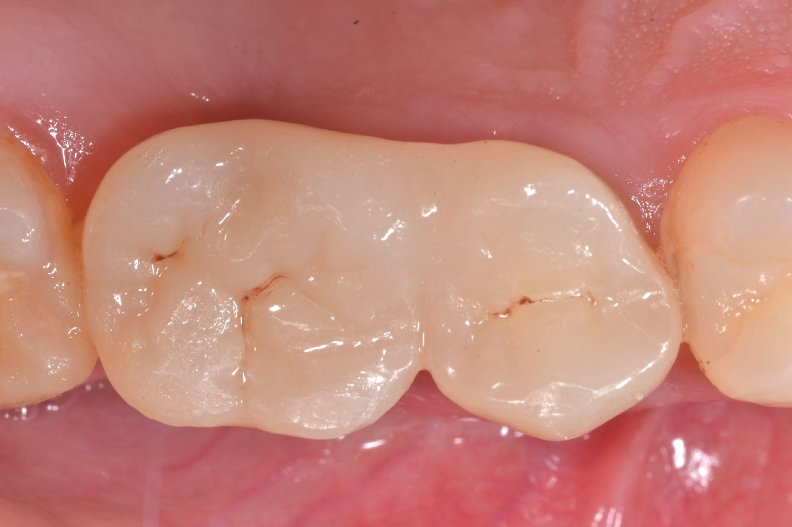
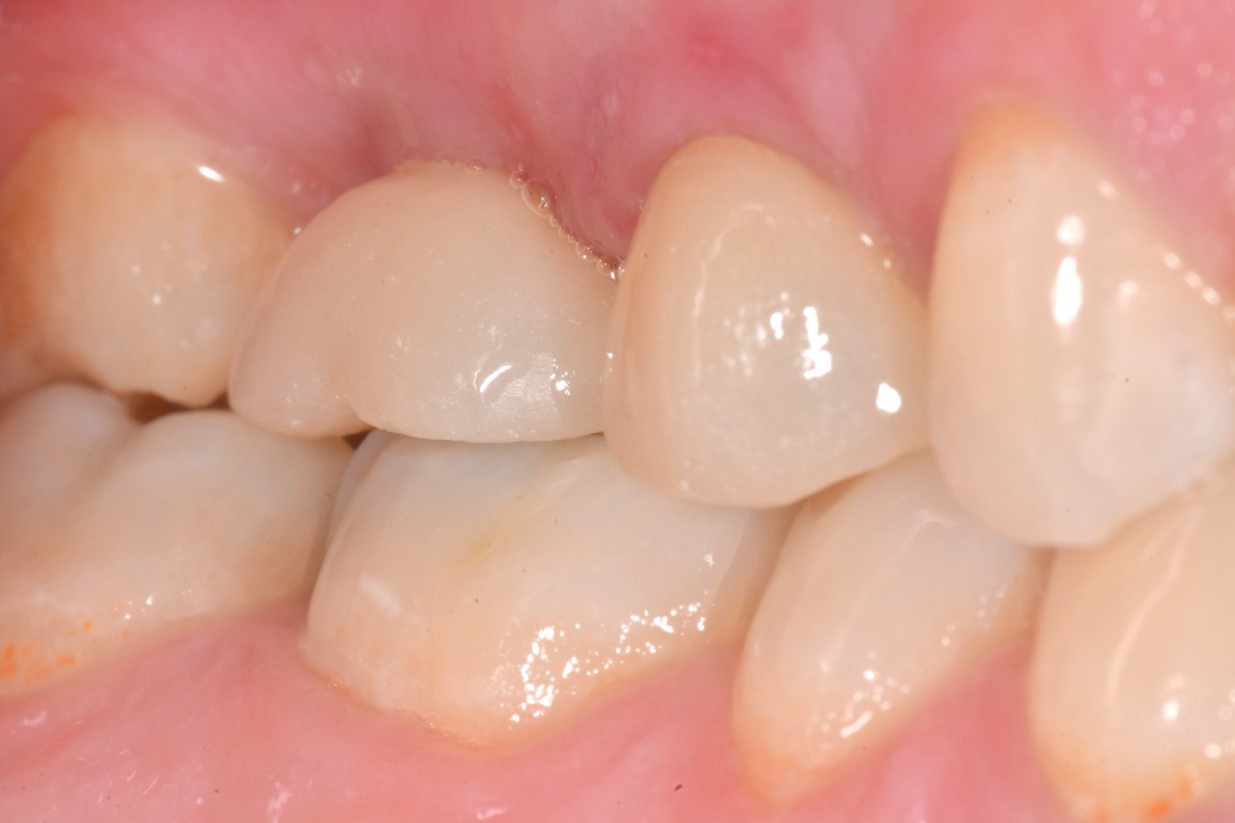
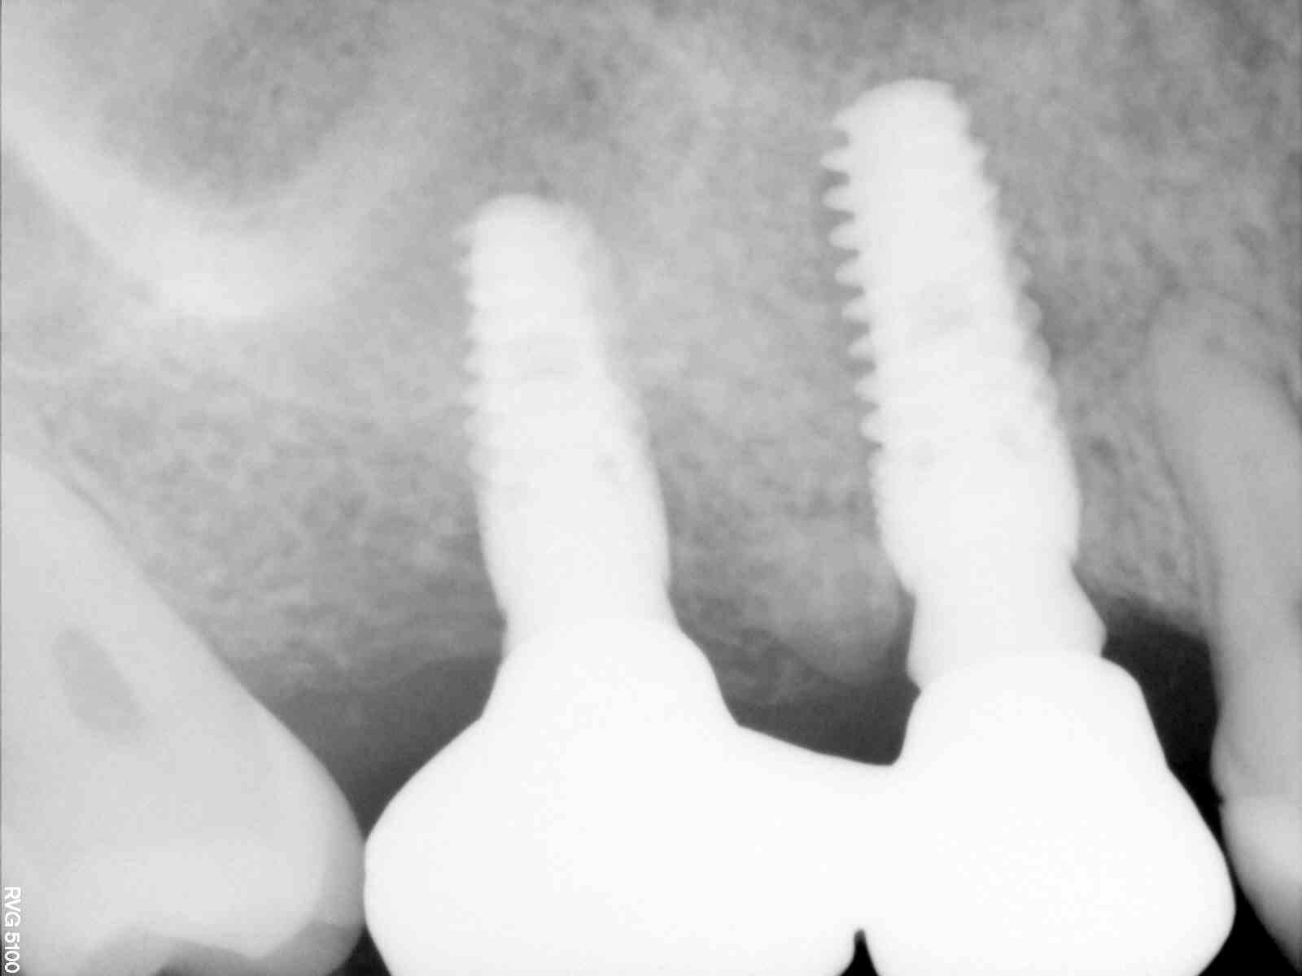
1° Case Report
9
10
11
11
12
13
13
13
14
9) Screw-retained provisional restoration 10) Radiographic view perfect connection of the abutments onto the implants 11) Immediate placement of the temporary restorations 12) Management of the soft tissues by temporary restorations 13) Definitive cemented restoration in zirconia 14) Radiograph at 5 months of follow-up

Slide 4
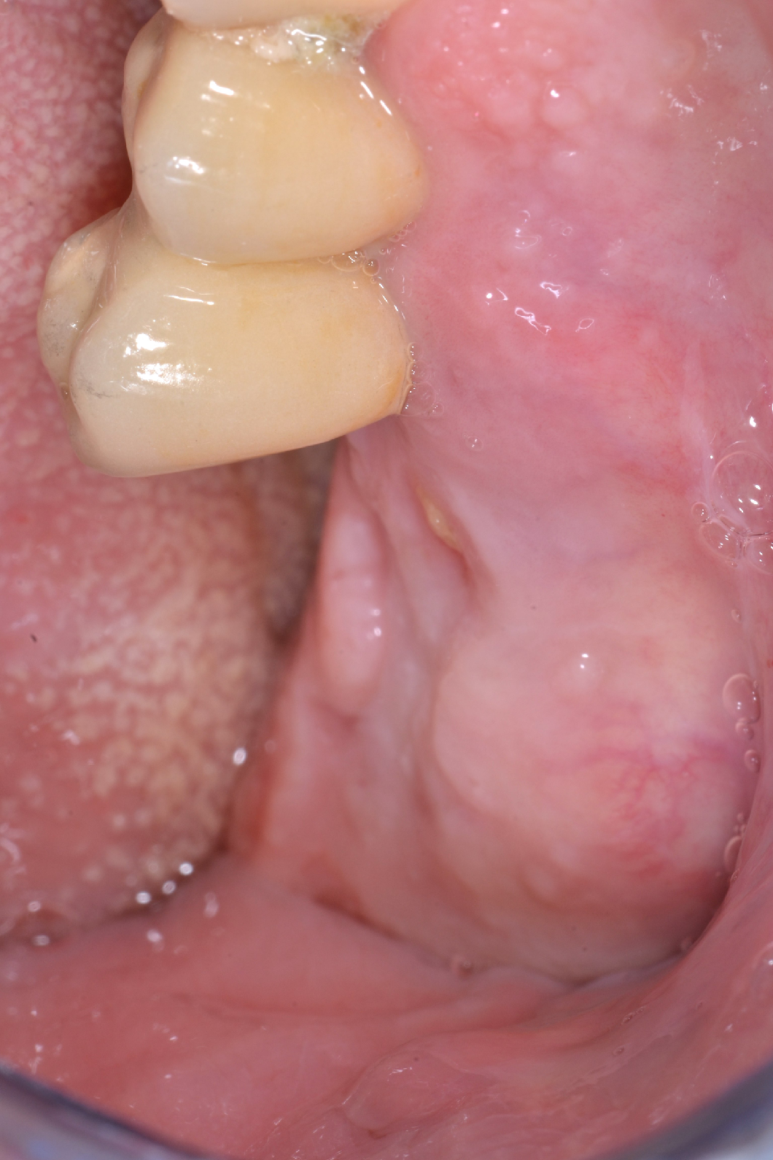
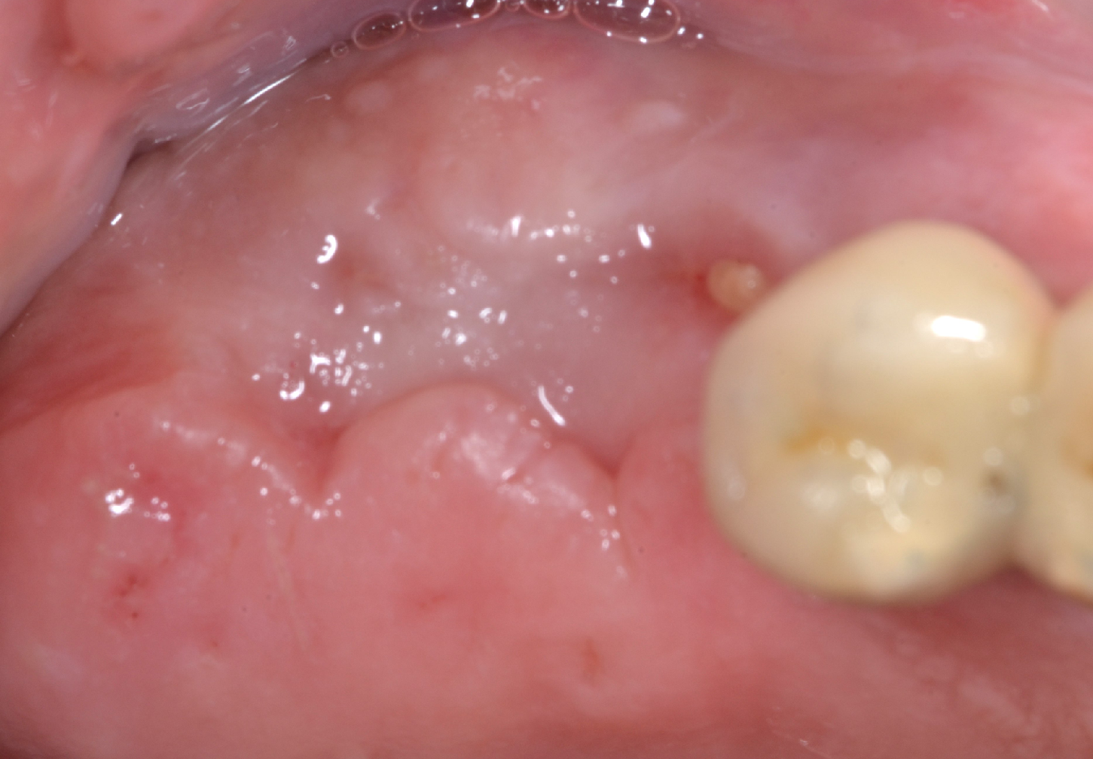
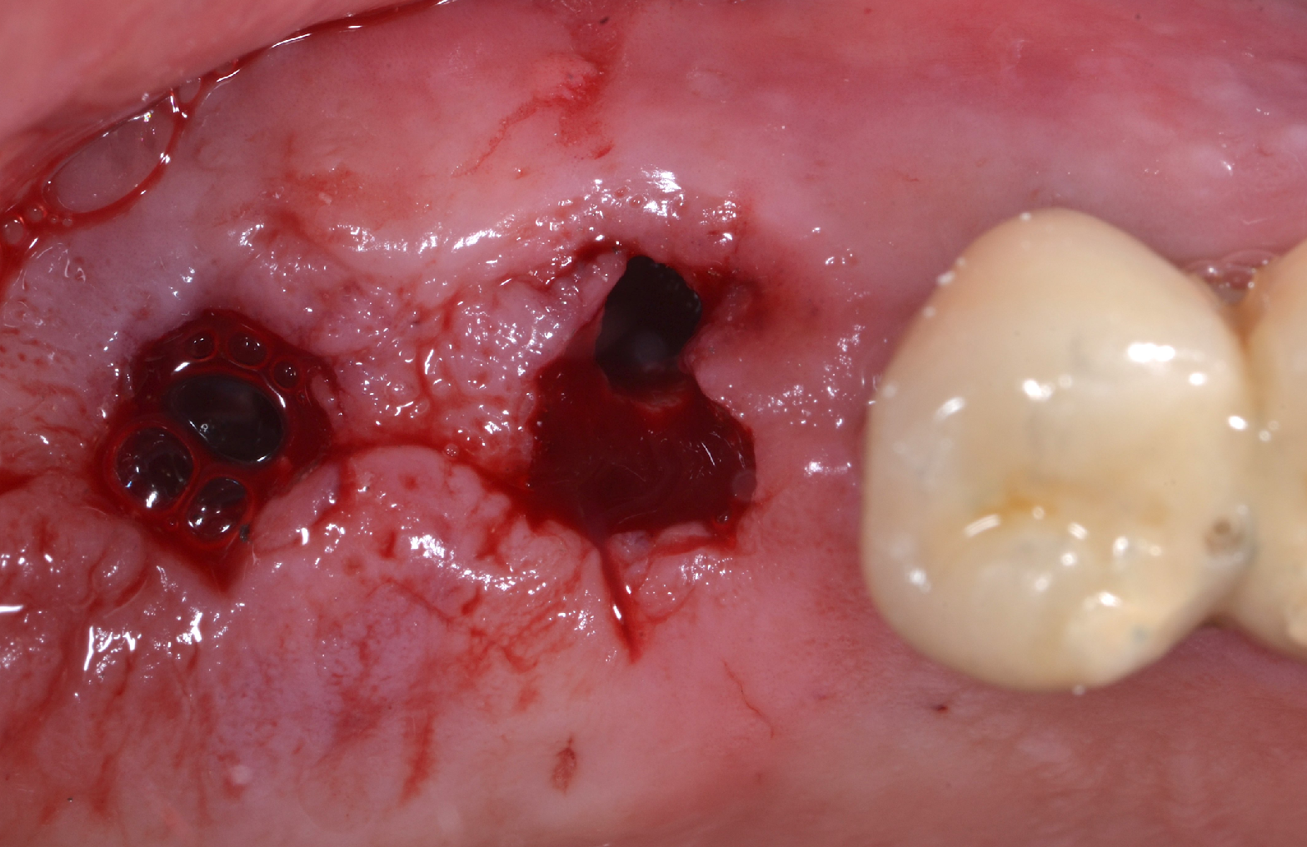
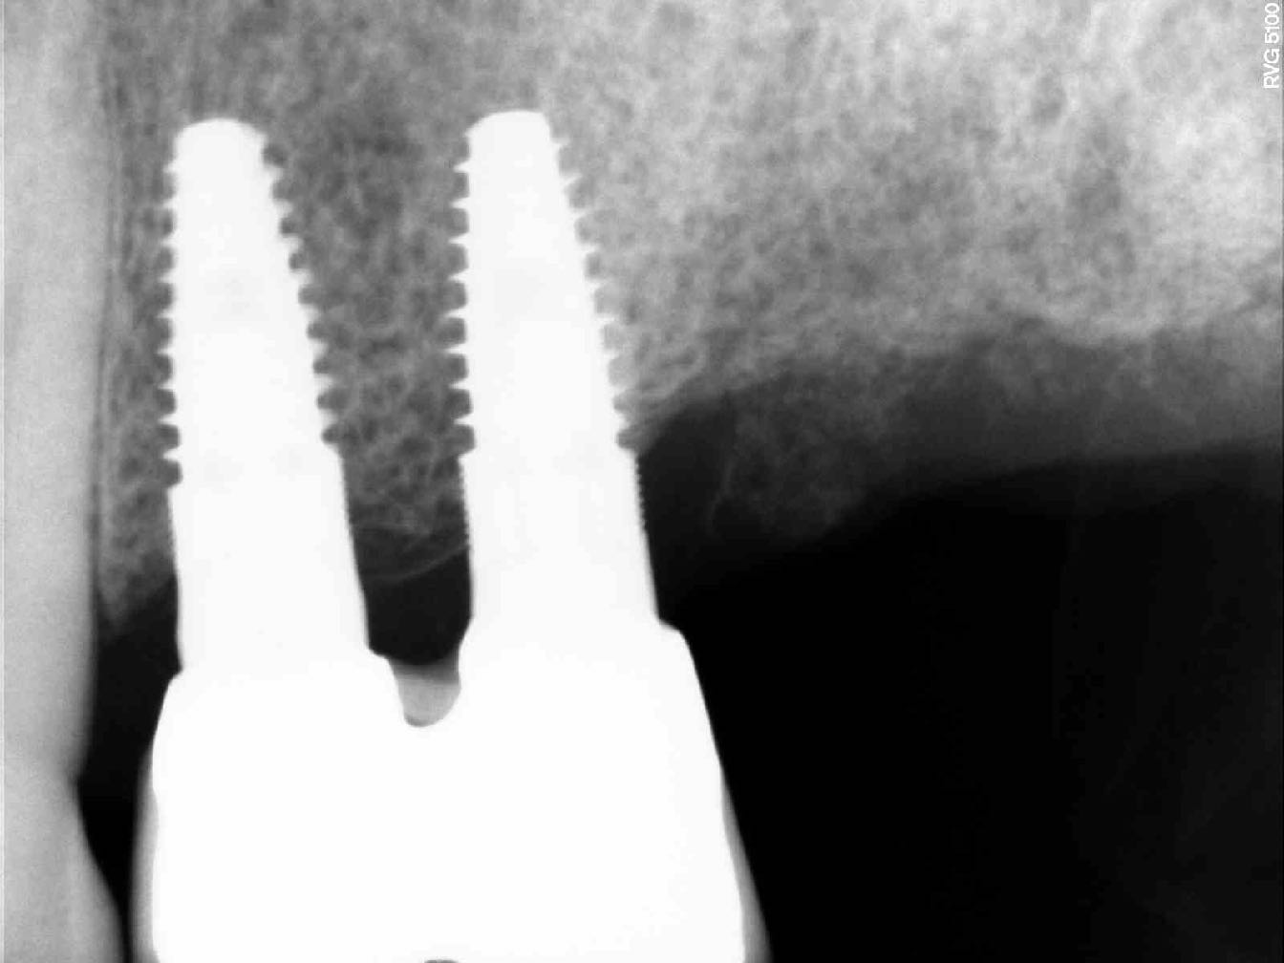
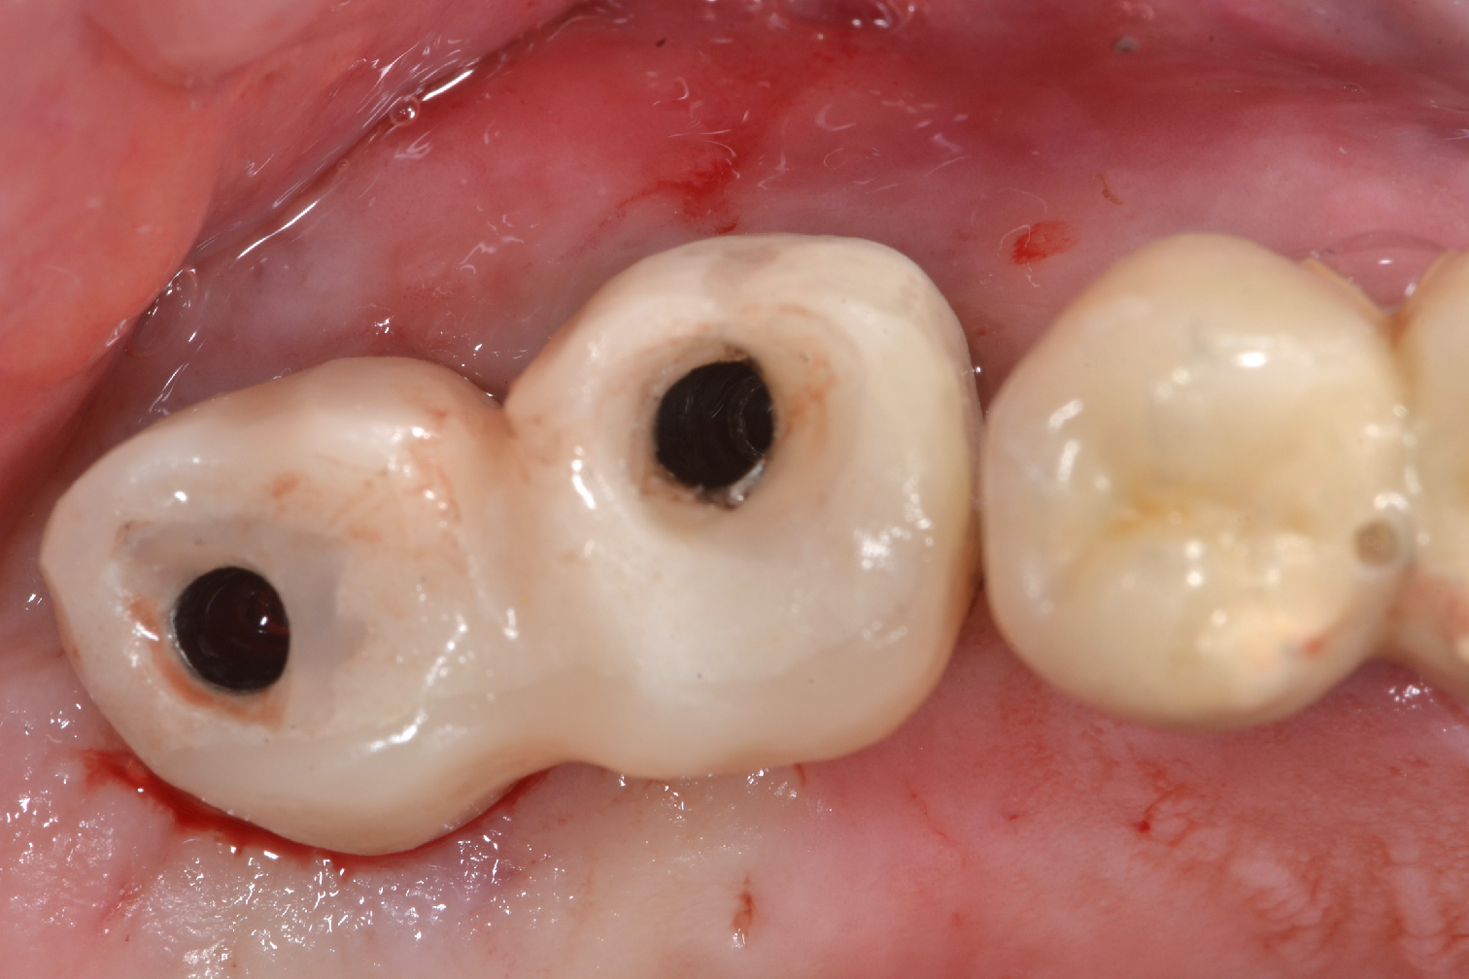
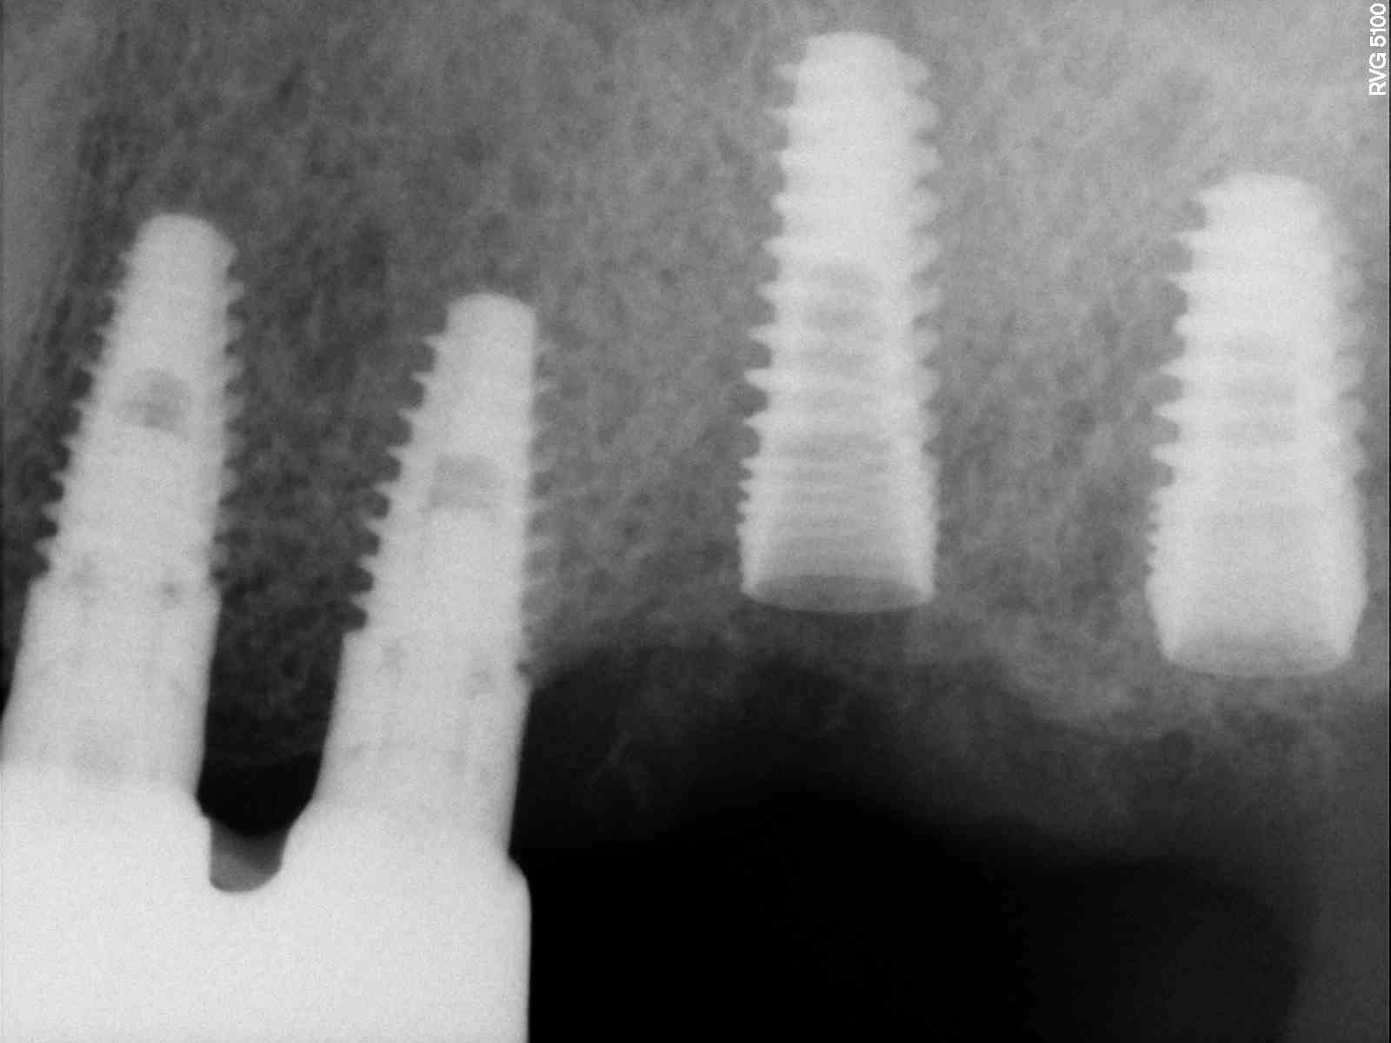
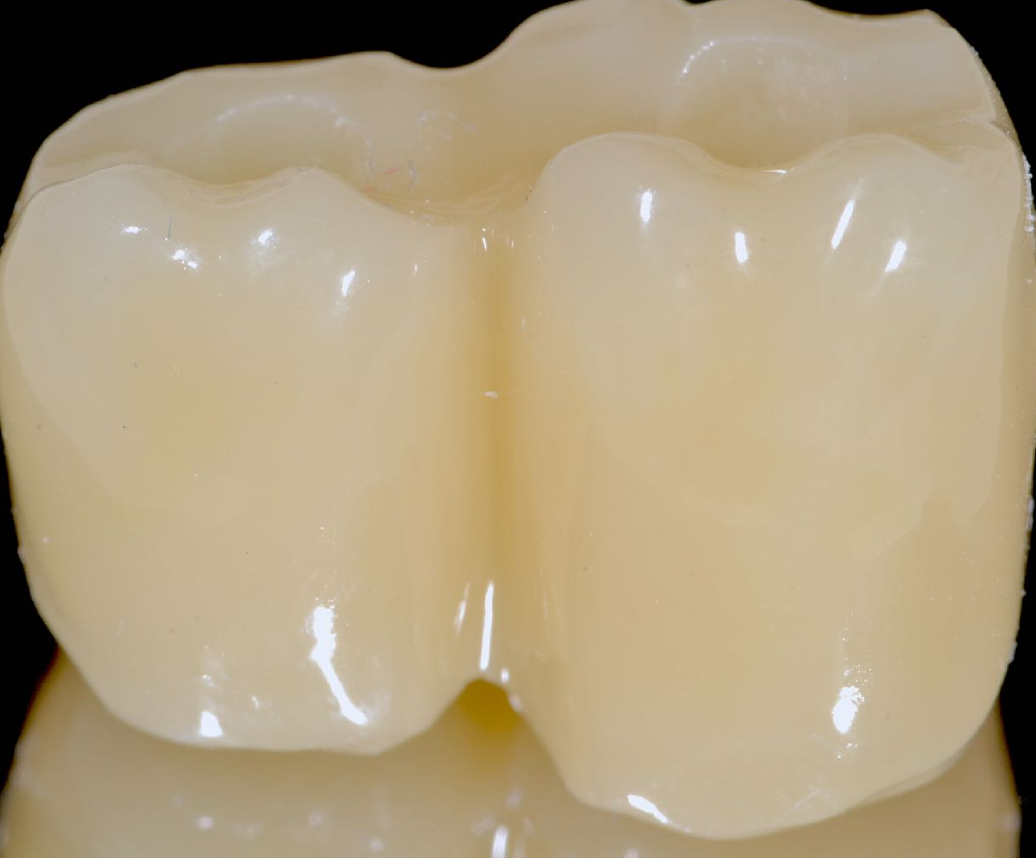
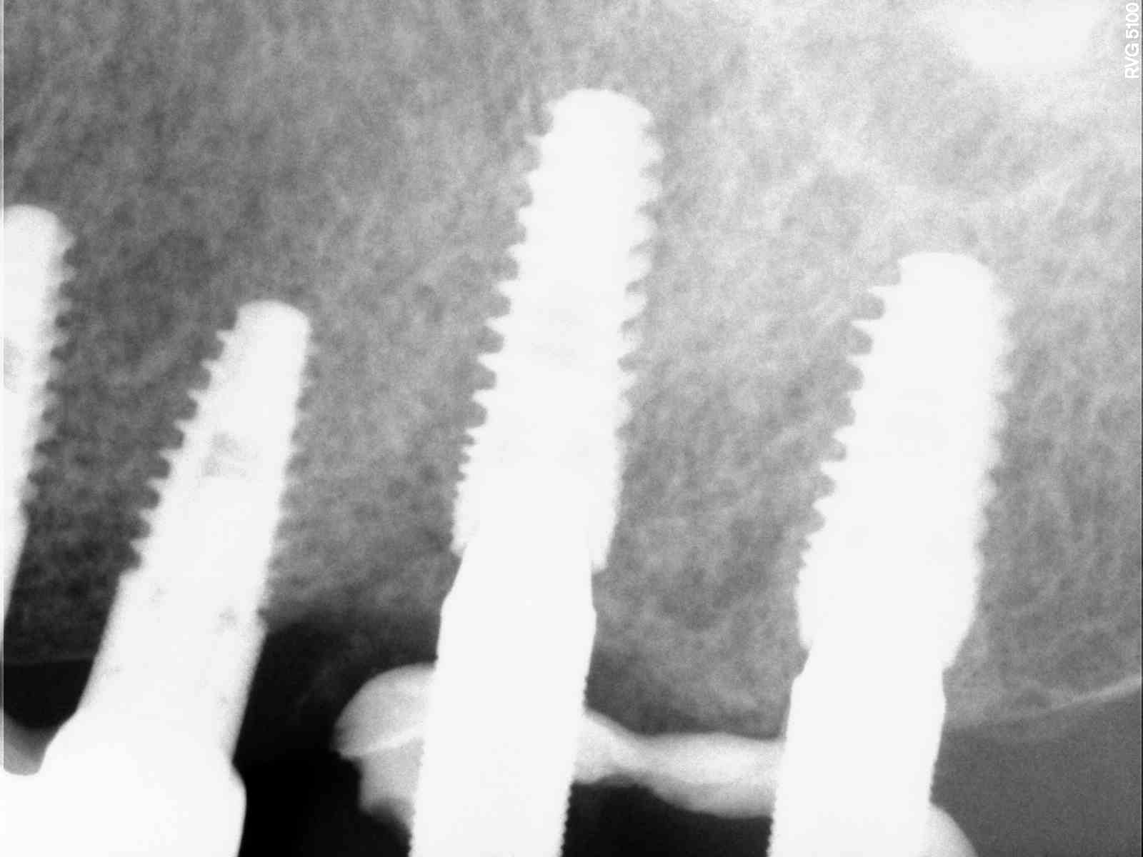
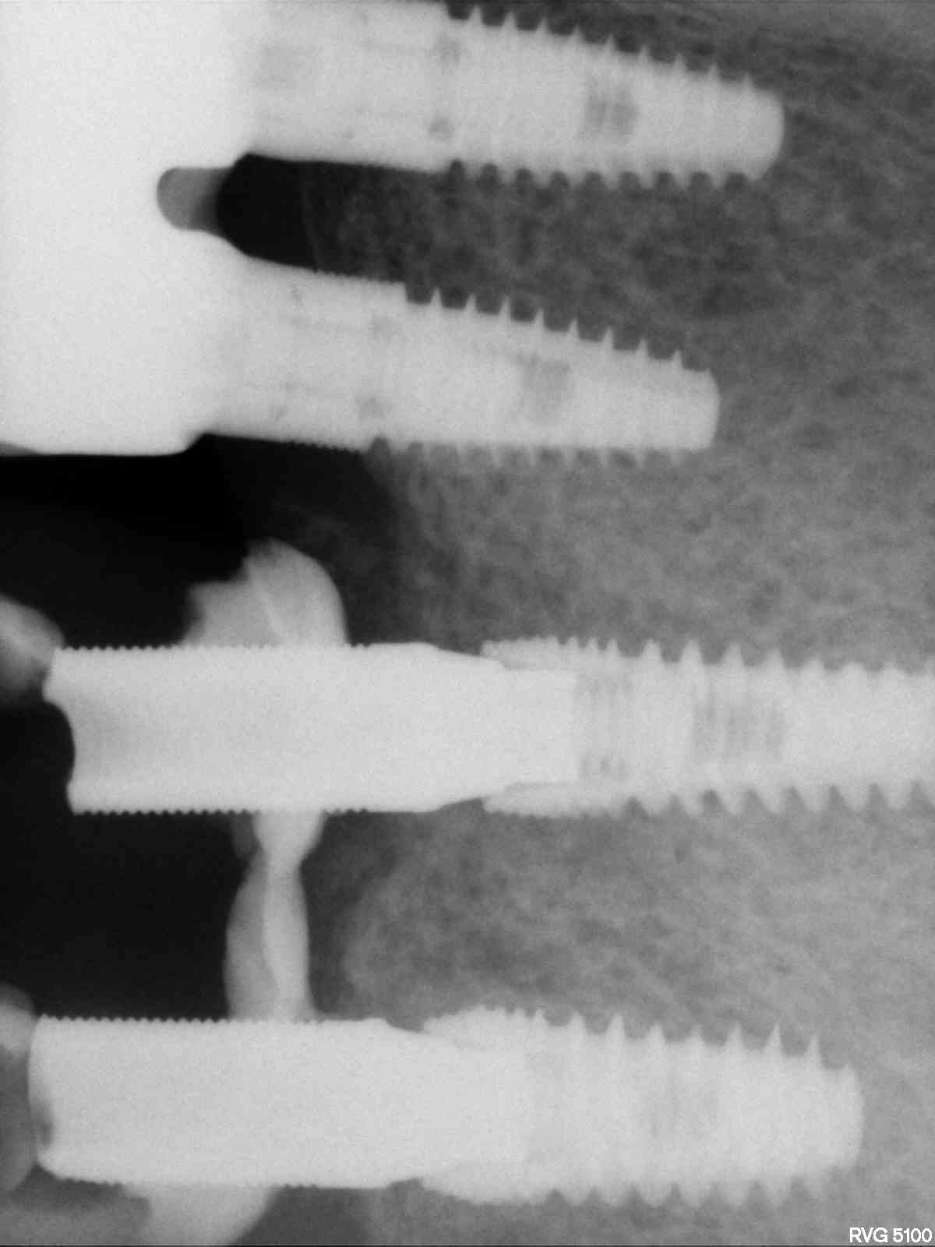
2° Case Report
1
2
3
1
4
5
6
7
8
9
Male patient (69 years old) in good health presenting edentulous space on the left upper maxilla.
1) Vertical and horizontal ridge’s dimension of the clinical pre-op situation 2) Radiographic evaluation pre-operatively 3) Flapless Implant Placement 4) Implant placement 2 mm below the crestal bone 5-6) Screw-retained provisional restorations 7) Radiograph taken immediately after surgery 8) Immediate placement of the screwed-retained temporary restorations 9) Radiograph after 4 months showing crestal bone stability.
Results: All implants exhibited torque values greater than 50 Ncm, even if all the implants have been inserted in the lateral/posterior areas of ​​the maxilla, where the bone quality is poor. Resonance frequency analysis (Osstell) presented ISQ-values higher than 65. The degree of patient satisfaction showed the maximum results.

Slide 5
Conclusion: The use of this implant design with high primary stability is possible even in situations of poor bone quality due to the multiple condensing thread design.
Moreover, with all the limitations of this preliminary study and the inclusion of a reduced number of implants, the recruitment of more patients with implant insertion and control over time is desirable to have a complete evaluation of peri-implant bone stability over time.
References:
1) Brånemark PI, Hansson BO, Adell R, et al. Osseointegrated implants in the treatment of the edentulous jaw. Experience from a 10-year period. Scand J Plast Reconstr Surg Suppl 1977;16:1-32.
2) Romanos G, Froum S, Hery C, et al. Survival of immediately vs. delayed loaded implants: Analysis of the current literature. J Oral Implantol 2010;36:315-324.
3) Esposito M, Grusovin MG, Willings M, et al. The effectiveness of immediate, early, and conventional loading of dental implants: A Cochrane systematic review of randomized controlled clinical trials. Int J Oral Maxillofac Implants 2007;22:893-904.

